Slide 1
William Stallings
Computer Organization and Architecture
6th Edition
Chapter 9
Computer Arithmetic

Slide 2
Arithmetic & Logic Unit
Does the calculations
Everything else in the computer is there to service this unit
Handles integers
May handle floating point (real) numbers
May be separate FPU (maths co-processor)

Slide 3
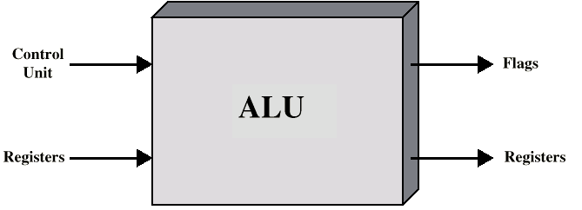
ALU Inputs and Outputs

Slide 4
Addition and Subtraction
Normal binary addition
Monitor sign bit for overflow
Take twos compliment of substahend and add to minuend
  i.e. a - b = a + (-b)
So we only need addition and complement circuits

Slide 5
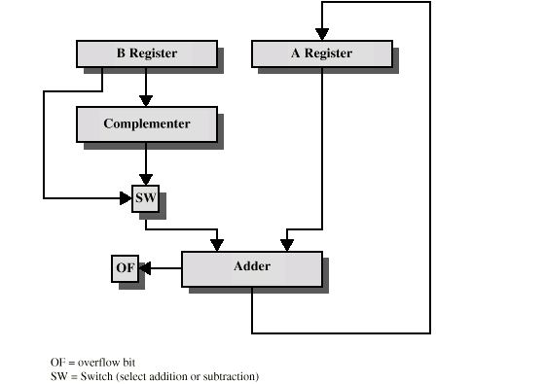
Hardware for Addition and Subtraction

Slide 6
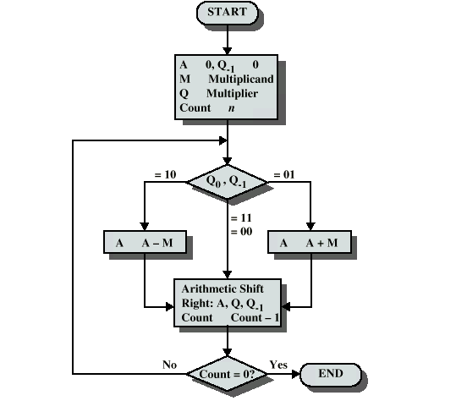
Booth’s Algorithm

Slide 7
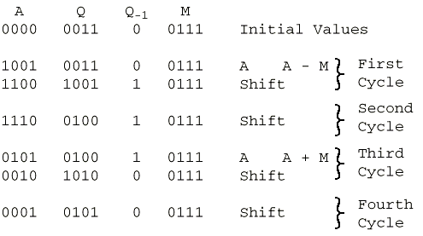
Example of Booth’s Algorithm:7(M)*3(Q)

Slide 8
Division
More complex than multiplication
Negative numbers are really bad!
Based on long division

Slide 9
Division of Unsigned Binary Integers
00001101
Quotient
Divisor
1011
10010011
Dividend
1011
001110
Partial
Remainders
1011
001111
1011
Remainder
100

Slide 10
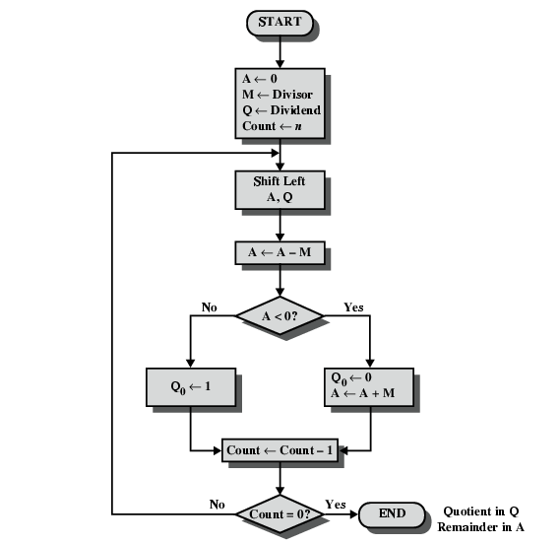
Flowchart for Unsigned Binary Division

Slide 11
Floating Point
Sign bit
Biased
Exponent
Significand or Mantissa
+/- .significand x 2^{exponent}
Misnomer
Point is actually fixed between sign bit and body of mantissa
Exponent indicates place value (point position)

Slide 12
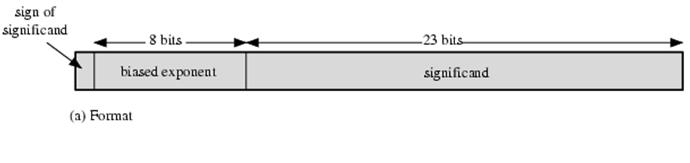
Floating Point Examples

Slide 13
Signs for Floating Point
Mantissa is stored in 2s compliment
Exponent is in excess or biased notation
  e.g. Excess (bias) 128 means
  8 bit exponent field
  Pure value range 0-255
  Subtract 128 to get correct value
  Range -128 to +127

Slide 14
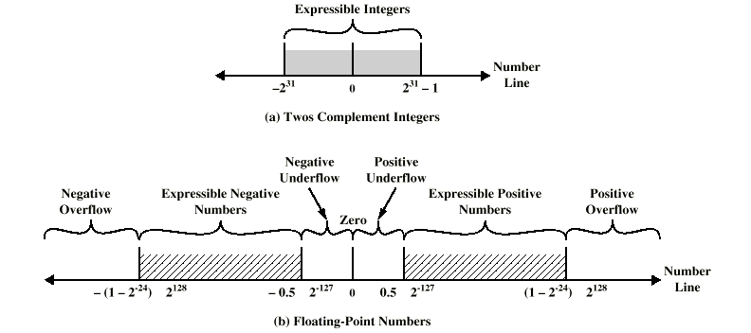
Expressible Numbers

Slide 15
IEEE 754
Standard for floating point storage
32 and 64 bit standards
8 and 11 bit exponent respectively
Extended formats (both mantissa and exponent) for intermediate results

Slide 16
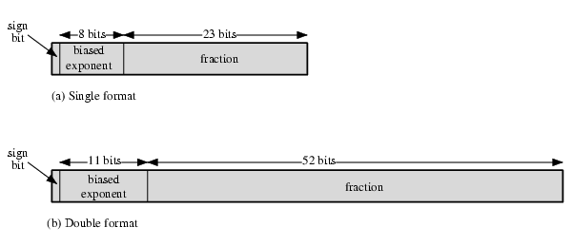
IEEE 754 Formats
(1.N)2^{E-127}
32 BIT
64 BIT
(1.N)2^{E-1023}

Slide 17
FP Arithmetic +/-
Check for zeros
Align significands (adjusting exponents)
Add or subtract significands
Normalize result

Slide 18
Floating Point Addition
Add the following two decimal numbers in scientific notation:
8.70 × 10⁻¹ with 9.95 × 10¹
Rewrite the smaller number such that its exponent matches with the exponent of the larger number.
8.70 × 10⁻¹ = 0.087 × 10¹

Slide 19
Add the mantissas
9.95 + 0.087 = 10.037 and
write the sum 10.037 × 10¹
Put the result in Normalised Form
10.037 × 10¹ = 1.0037 × 10²
(shift mantissa, adjust exponent)

Slide 20
Check for overflow/underflow of the exponent after normalisation
Overflow
The exponent is too large to be represented in the Exponent field
Underflow
The number is too small to be represented in the Exponent field

Slide 21
Round the result
If the mantissa does not fit in the space reserved for it, it has to be rounded off.
For Example: If only 4 digits are allowed for mantissa
1.0037 × 10² ===> 1.004 × 10²

Slide 22
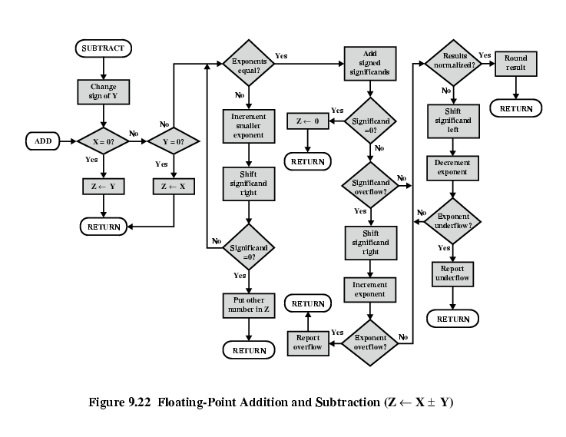
FP Addition & Subtraction Flowchart

Slide 23
FP Arithmetic x/÷
Check for zero
Add/subtract exponents
Multiply/divide significands (watch sign)
Normalize
Round
All intermediate results should be in double length storage

Slide 24
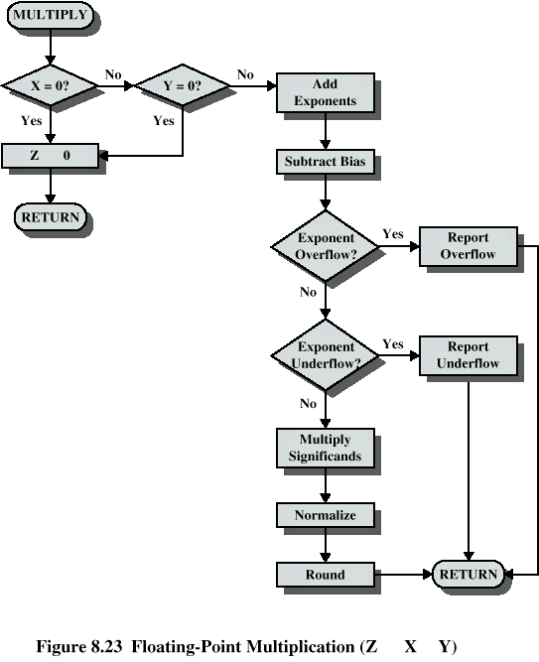
Floating Point Multiplication

Slide 25
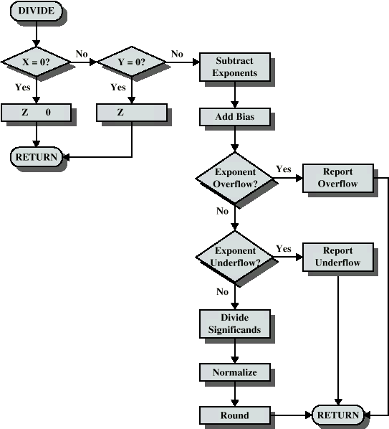
Floating Point Division

